Slide 1
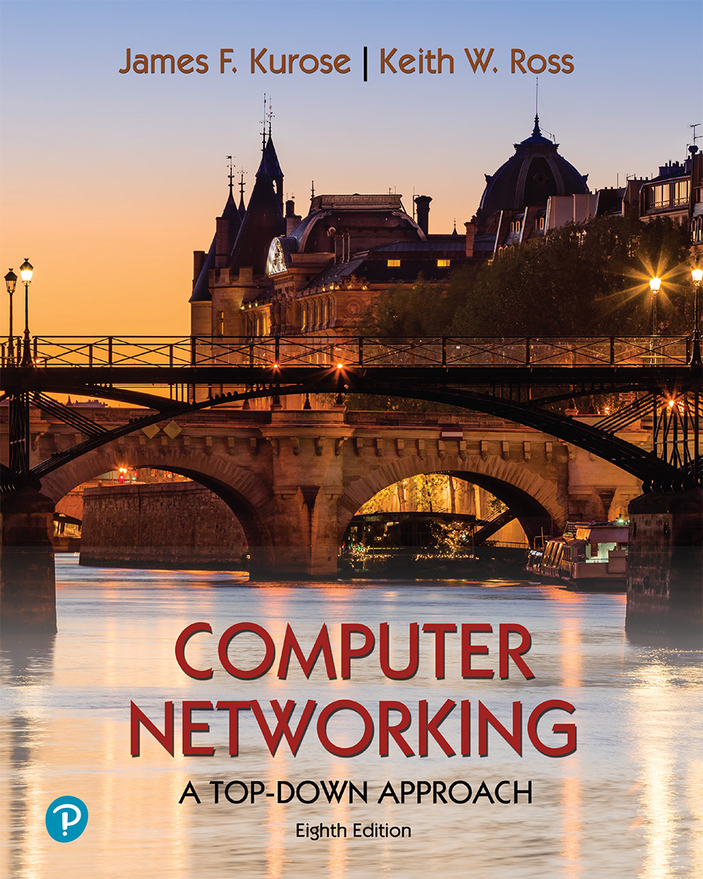
Chapter 5 Network Layer:
Control Plane
A note on the use of these PowerPoint slides:
We’re making these slides freely available to all (faculty, students, readers). They’re in PowerPoint form so you see the animations; and can add, modify, and delete slides (including this one) and slide content to suit your needs. They obviously represent a lot of work on our part. In return for use, we only ask the following:
If you use these slides (e.g., in a class) that you mention their source (after all, we’d like people to use our book!)
If you post any slides on a www site, that you note that they are adapted from (or perhaps identical to) our slides, and note our copyright of this material.
For a revision history, see the slide note for this page.
Thanks and enjoy! JFK/KWR
All material copyright 1996-2020
J.F Kurose and K.W. Ross, All Rights Reserved
Computer Networking: A Top-Down Approach 8th edition Jim Kurose, Keith Ross Pearson, 2020
Notes:
Version History
8.0 (May 2020)
All slides reformatted for 16:9 aspect ratio
All slides updated to 8th edition material
Use of Calibri font, rather that Gill Sans MT
Add LOTS more animation throughout
lighter header font
Re-do of network management slides; redo of Bellman-Ford slides

Slide 2
Network-layer functions
forwarding: move packets from router’s input to appropriate router output
data plane
routing: determine route taken by packets from source to destination
control plane
Two approaches to structuring network control plane:
per-router control (traditional)
logically centralized control (software defined networking)

Slide 3

Per-router control plane
Individual routing algorithm components in each and every router interact in the control plane
Routing
Algorithm
control
plane
data
plane
values in arriving
packet header
0111
1
3
2

Slide 4
Software defined networking (SDN)
Internet network layer: historically implemented via distributed, per-router control approach:
monolithic router contains switching hardware, runs proprietary implementation of Internet standard protocols (IP, RIP, IS-IS, OSPF, BGP) in proprietary router OS (e.g., Cisco IOS)
different “middleboxes” for different network layer functions: firewalls, load balancers, NAT boxes, ..
~2005: renewed interest in rethinking network control plane

Slide 5
Software-Defined Networking (SDN) control plane
Remote controller computes, installs forwarding tables in routers
Remote Controller
control
plane
data
plane
CA
CA
CA
CA
CA
values in arriving
packet header
0111
1
3
2

Slide 6
Software defined networking (SDN)
Why a logically centralized control plane?
easier network management: avoid router misconfigurations, greater flexibility of traffic flows
table-based forwarding (recall OpenFlow API) allows “programming” routers
centralized “programming” easier: compute tables centrally and distribute
distributed “programming” more difficult: compute tables as result of distributed algorithm (protocol) implemented in each-and-every router
open (non-proprietary) implementation of control plane
foster innovation: let 1000 flowers bloom

Slide 7





SDN analogy: mainframe to PC revolution
App
App
App
App
App
App
App
App
App
App
App
Specialized
Applications
Open Interface
Specialized
Operating
System
or
or
Windows
Linux
MAC OS
Specialized
Hardware
Open Interface
Microprocessor
Vertically integrated
Closed, proprietary
Slow innovation
Small industry
Horizontal
Open interfaces
Rapid innovation
Huge industry
* Slide courtesy: N. McKeown

Slide 8

Traffic engineering: difficult with traditional routing
5
3
v
w
5
2
u
2
1
z
3
1
2
x
y
1
Q: what if network operator wants u-to-z traffic to flow along uvwz, rather than uxyz?
A: need to re-define link weights so traffic routing algorithm computes routes accordingly (or need a new routing algorithm)!
link weights are only control “knobs”: not much control!

Slide 9
Traffic engineering: difficult with traditional routing
5
3
v
w
5
2
u
2
1
z
3
1
2
x
y
1
Q: what if network operator wants to split u-to-z traffic along uvwz and uxyz (load balancing)?
A: can’t do it (or need a new routing algorithm)

Slide 10
Traffic engineering: difficult with traditional routing
5
3
v
w
5
2
u
2
1
z
3
1
2
x
y
1
Q: what if w wants to route blue and red traffic differently from w to z?
A: can’t do it (with destination-based forwarding, and LS, DV routing)
We learned in Chapter 4 that generalized forwarding and SDN can be used to achieve any routing desired

Slide 11
Software defined networking (SDN)
…
3. control plane functions external to data-plane switches
4. programmable control applications
routing
access control
load
balance
Remote Controller
control
plane
data
plane
CA
2. control, data plane separation
CA
CA
CA
CA
1: generalized “flow-based” forwarding (e.g., OpenFlow)

Slide 12
Software defined networking (SDN)
Data-plane switches:
fast, simple, commodity switches implementing generalized data-plane forwarding (Section 4.4) in hardware
flow (forwarding) table computed, installed under controller supervision
API for table-based switch control (e.g., OpenFlow)
defines what is controllable, what is not
protocol for communicating with controller (e.g., OpenFlow)
network-control applications
…
routing
access
control
load
balance
control
plane
northbound API
SDN Controller
(network operating system)
southbound API
data
plane
SDN-controlled switches

Slide 13
Software defined networking (SDN)
network-control apps:
“brains” of control: implement control functions using lower-level services, API provided by SDN controller
unbundled: can be provided by 3rd party: distinct from routing vendor, or SDN controller
network-control applications
…
routing
access
control
load
balance
control
plane
northbound API
SDN Controller
(network operating system)
southbound API
data
plane
SDN-controlled switches

Slide 14
Software defined networking (SDN)
SDN controller (network OS):
maintain network state information
interacts with network control applications “above” via northbound API
interacts with network switches “below” via southbound API
implemented as distributed system for performance, scalability, fault-tolerance, robustness
network-control applications
…
routing
access
control
load
balance
control
plane
northbound API
SDN Controller
(network operating system)
southbound API
data
plane
SDN-controlled switches

Slide 15
Components of SDN controller
routing
access
control
load
balance
interface layer to network control apps: abstractions API
Interface, abstractions for network control apps
…
network graph
RESTful
API
intent
…
network-wide state management : state of networks links, switches, services: a distributed database
statistics
flow tables
SDN
controller
Network-wide distributed, robust state management
…
Link-state info
host info
switch info
…
communication: communicate between SDN controller and controlled switches
OpenFlow
SNMP
Communication to/from controlled devices

Slide 16

OpenFlow protocol
operates between controller, switch
TCP used to exchange messages
optional encryption
three classes of OpenFlow messages:
controller-to-switch
asynchronous (switch to controller)
symmetric (misc.)
distinct from OpenFlow API
API used to specify generalized forwarding actions
OpenFlow Controller

Slide 17
OpenFlow: controller-to-switch messages
Key controller-to-switch messages
features: controller queries switch features, switch replies
configure: controller queries/sets switch configuration parameters
modify-state: add, delete, modify flow entries in the OpenFlow tables
packet-out: controller can send this packet out of specific switch port
OpenFlow Controller

Slide 18
OpenFlow: switch-to-controller messages
Key switch-to-controller messages
packet-in: transfer packet (and its control) to controller. See packet-out message from controller
flow-removed: flow table entry deleted at switch
port status: inform controller of a change on a port.
OpenFlow Controller
Fortunately, network operators don’t “program” switches by creating/sending OpenFlow messages directly. Instead use higher-level abstraction at controller

Slide 19

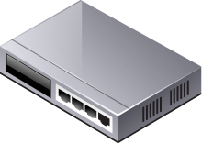
Topology Discovery in OpenFlow
Purpose
To construct an entire network view
Method
Use the Link Layer Discovery Protocol (LLDP)
IDX | SRC | DST | SRC PORT | DST PORT
153 | sw. A | sw. B | p2 | p1
… | … | … | … | …
357 | sw. B | sw. A | P1 | p2
OpenFlow Controller
PACKET_OUT with LLDP
PACKET_OUT with LLDP
p1
PACKET_IN with LLDP
p2
p2
LLDP
p1
Notes:
OpenFlow Switch 포트의 status 정보를 스위치에서 Controller에 보내면서 Topology Discovery가 이루어진다.
스위치의 포트가 Down에서 Up으로 변경된다.
이 포트의 변경 사항을 Switch에서 Controller에 보낸다.
Controller는 LLDP가 Switch의 변경된 포트를 통해 전송되도록 Packet Out Message로 생성하여 전송한다.
이것을 수신한 Switch는 Packet Out Message에 담긴 LLDP를 인접한 Switch에 전달한다.
LLDP를 받은 인접한 Switch는 해당 LLDP를 어떻게 처리해야 할지를 모르기 때문에 이 Packet을 Controller에 Packet In Message 형태로 보낸다.
Controller는 이를 통해 스위치 간 연결 정보를 확인한다.

Slide 20

Packet Forwarding in OpenFlow
Packet Forwarding
Reactive flow insertion
A non-matched packet reaches to OpenFlow switch, it is sent to the controller, based on the info in packet header, an appropriate flow will be inserted
Always need to query the path from controller during packet arrival → slow
Can reflect the current traffic status
Proactive flow insertion
Flow can be inserted proactively by the controller to switches before packet arrives
No need to communicate during packet arrival → fast packet forwarding
Cannot reflect the current traffic status
SRC | DST | ACT | …
OpenFlow Controller
SRC | DST | ACT | …
h1 | h2 | p2
h1 h2 p2
acquire route
insert flow
1
2
1
2
host1
switch1 (reactive)
switch2 (proactive)
host2

Slide 21
SDN: control/data plane interaction example
Dijkstra’s link-state
routing
1
S1, experiencing link failure uses OpenFlow port status message to notify controller
4
…
network graph
RESTful
API
intent
3
…
2
SDN controller receives OpenFlow message, updates link status info
statistics
flow tables
…
Link-state info
host info
switch info
3
2
Dijkstra’s routing algorithm application has previously registered to be called when ever link status changes. It is called.
…
OpenFlow
SNMP
1
4
Dijkstra’s routing algorithm access network graph info, link state info in controller, computes new routes
s2
s1
s4
s3

Slide 22
SDN: control/data plane interaction example
Dijkstra’s link-state
routing
4
5
…
network graph
RESTful
API
intent
5
link state routing app interacts with flow-table-computation component in SDN controller, which computes new flow tables needed
3
…
statistics
flow tables
…
Link-state info
host info
switch info
2
…
OpenFlow
SNMP
6
controller uses OpenFlow to install new tables in switches that need updating
1
6
s2
s1
s4
s3

Slide 23
SDN: selected challenges
hardening the control plane: dependable, reliable, performance-scalable, secure distributed system
robustness to failures: leverage strong theory of reliable distributed system for control plane
dependability, security: “baked in” from day one?
networks, protocols meeting mission-specific requirements
e.g., real-time, ultra-reliable, ultra-secure
Internet-scaling: beyond a single AS
SDN critical in 5G cellular networks

Slide 24

SDN and the future of traditional network protocols
SDN-computed versus router-computed forwarding tables:
just one example of logically-centralized-computed versus protocol computed
one could imagine SDN-computed congestion control:
controller sets sender rates based on router-reported (to controller) congestion levels
How will implementation of network functionality (SDN versus protocols) evolve?

